Slide 1



Basic Bottom-up Parsing Techniques, SLR and Shift-reduce parsers

Slide 2
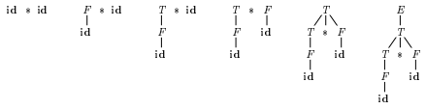
BASIC BOTTOM-UP PARSING TECHNIQUES
It is convenient to describe parsing as the process of building parse trees, although a front end may in fact carry out a translation directly without building an explicit tree.
A bottom-up parse for id*id

Slide 3
BASIC BOTTOM-UP PARSING TECHNIQUES
A bottom-up parser creates the parse tree of the given input starting from leaves towards the root.
A bottom-up parser tries to find the right-most derivation of the given input in the reverse order.
(a) S ⇒ ... ⇒ ω (the right-most derivation of ω)
(b) ← (the bottom-up parser finds the right-most derivation in the reverse order)
Bottom-up parsing is also known as shift-reduce parsing because its two main actions are shift and reduce.

Slide 4
BASIC BOTTOM-UP PARSING TECHNIQUES
At each shift action, the current symbol in the input string is pushed to a stack.
At each reduction step, the symbols at the top of the stack (this symbol sequence is the
right side of a production) will replaced by the non-terminal at the left side of that production.
There are also two more actions: accept and error.

Slide 5
ISSUES IN BOTTOM-UP PARSING
1. How do we know which action to take
Whether to shift or reduce
Which production to use for reduction?
2. Sometimes parser can reduce but it should not:
X → E can always be used for reduction
3. Sometimes parser can reduce in different ways
4. Given stack δ and input symbol a, should the parser
– Shift a onto stack (making it δa)
–Reduce by some production A→β assuming that stack has form αβ (making it αA)
– Stack can have many combinations of αβ
–How to keep track of length of β?

Slide 6
SHIFT-REDUCE PARSING
A shift-reduce parser tries to reduce the given input string into the starting symbol.
At each reduction step, a substring of the input matching to the right side of a production rule is replaced by the non-terminal at the left side of that production rule.
If the substring is chosen correctly, the right most derivation of that string is created in the reverse order.

Slide 7
SHIFT-REDUCE PARSING
EXAMPLE:
For Grammar:
S → aABb
A → aA | a
B → bB | b
Input string: aaabb
aaabb ⇒ aaAbb ⇒ aAbb ⇒ aABb ⇒ S
The above reduction corresponds to the following rightmost derivation: S ⇒ aABb ⇒ aAbb ⇒ aaAbb ⇒ aaabb

Slide 8
HANDLE
• The basic steps of a bottom-up parser are
– to identify a substring within a rightmost sentential form which matches the RHS of a rule.
– when this substring is replaced by the LHS of the matching rule, it must produce the previous rightmost-sentential form. • Such a substring is called a handle

Slide 9
HANDLE
• Informally, a handle of a string is a substring that matches the right side of a production rule.
But not every substring that matches the right side of a production rule is handle.
• A handle of a right sentential form γ (≡ αβω) is a production rule A → β and a position of γ where the string β may be found and replaced by A to produce the previous right-sentential form in a rightmost derivation of γ.
S ⇒ αAω ⇒ αβω

Slide 10
HANDLE
• If the grammar is unambiguous, then every right-sentential form of the grammar has exactly one handle.
• We will see that ω is a string of terminals.
• A right-most derivation in reverse can be obtained by handle-pruning.
S=γ0 ⇒ γ1 ⇒ γ2 ⇒ ... ⇒ γn-1 ⇒ γn= ω ←input string
• Start from γn, find a handle An→βn in γn, and replace βn in by An to get γn-1.
• Then find a handle An-1→βn-1 in γn-1, and replace βn-1 in by An-1 to get γn-2. • Repeat this, until we reach S.

Slide 11
HANDLE EXAMPLE
E→ E + T | T
T→T * F | F
F→ ( E ) | id
Right-Most Derivation of id+id*id is
E ⇒ E+T ⇒ E+T*F ⇒ E+T*id ⇒ E+F*id
⇒ E+id*id ⇒ T+id*id ⇒ F+id*id ⇒ id+id*id

Slide 12
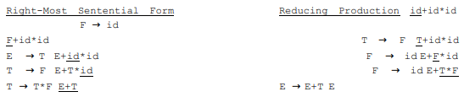
HANDLE EXAMPLE
Handles are underlined in the right-sentential forms.

Slide 13
HANDLE EXAMPLE
Consider the following grammar
E→ E + E
E→ E * E
E→ ( E )
E→ id
And the rightmost derivation
E→ E + E
E→ E + E * E
E→ E + E * id3
E→ E + id2 * id3
E→ id1 + id2 * id3

Slide 14
HANDLE PRUNING
• We only want to reduce handle and not any RHS
• Handle pruning: If β is a handle and A → β is a production then replace β by A
• A right most derivation in reverse can be obtained by handle pruning.
• Only terminal symbols can appear to the right of a handle in a rightmost sentential form.
• Why?

Slide 15
HANDLE
Is this scenario possible:
• 𝛼𝛽𝛾 is the content of the stack
• 𝐴 → 𝛾 is a handle
• The stack content reduces to 𝛼𝛽𝐴
• Now B → 𝛽 is the handle
In other words, handle is not on top, but buried inside stack
• Consider two cases of right most derivation to understand the fact that handle appears on the top of the stack
𝑆 → 𝛼𝐴𝑧 → 𝛼𝛽𝐵𝑦𝑧 → 𝛼𝛽𝛾𝑦𝑧
𝑆 → 𝛼𝐵𝑥𝐴𝑧 → 𝛼𝐵𝑥𝑦𝑧 → 𝛼𝛾𝑥𝑦z

Slide 16
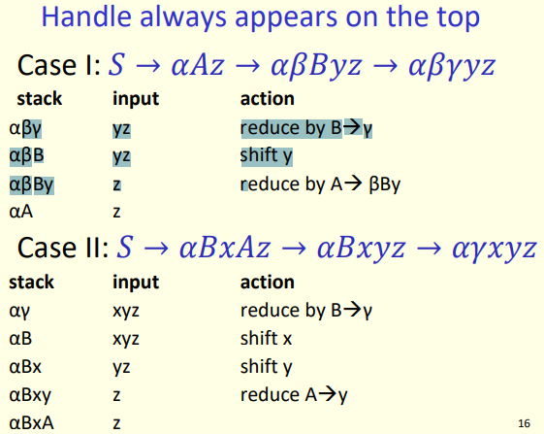
HANDLE

Slide 17
STACK IMPLEMENTATION
Shift-reduce parsing is a form of bottom-up parsing in which a stack holds grammar symbols and an input buffer holds the rest of the string to be parsed. As we shall see, the handle always appears at the top of the stack just before it is identified as the handle.
We use $ to mark the bottom of the stack and also the right end of the input. Conventionally, when discussing bottom-up parsing, we show the top of the stack on the right, rather than on the left as we did for top-down parsing.

Slide 18
STACK IMPLEMENTATION
Initially, the stack is empty, and the string w is on the input, as follows: STACK INPUT
$ w$
During a left-to-right scan of the input string, the parser shifts zero or more input symbols onto the stack, until it is ready to reduce a string 𝛽 of grammar symbols on top of the stack. It then reduces 𝛽 to the head of the appropriate production. The parser repeats this cycle until it has detected an error or until the stack contains the start symbol and the input is empty. STACK INPUT
$S $

Slide 19
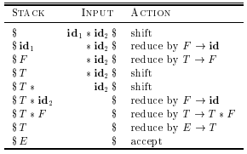
STACK IMPLEMENTATION
Example:
Configuration of a shift-reduce parser on input id1 *id2

Slide 20
STACK IMPLEMENTATION
There are two problems that must be solved if we are to parse by handle pruning.
The first is to locate the substring to be reduced in a right-sentential form.
And the second is to determine what production to choose incase there is more than one production with that substring on the right side.

Slide 21
STACK IMPLEMENTATION
• There are four possible actions of a shift-parser action:
• Shift : The next input symbol is shifted onto the top of the stack.
• Reduce: Replace the handle on the top of the stack by the non-terminal.
• Accept: Successful completion of parsing.
• Error: Parser discovers a syntax error, and calls an error recovery routine.
• Initial stack just contains only the end-marker $.
• The end of the input string is marked by the end-marker $

Slide 22
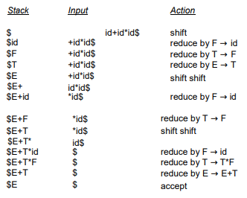
STACK IMPLEMENTATION EXAMPLE

Slide 23
SHIFT REDUCE PARSING
• The general shift-reduce technique is:
– if there is no handle on the stack then shift
– If there is a handle then reduce
• Bottom up parsing is essentially the process of detecting handles and reducing them.
• Different bottom-up parsers differ in the way they detect handles.
• There are context-free grammars for which shift-reduce parsers cannot be used.

Slide 24
CONFLICTS DURING SHIFT REDUCE PARSING
• Stack contents and the next input symbol may not decide action:
– shift/reduce conflict: Whether make a shift operation or a reduction.
– reduce/reduce conflict: The parser cannot decide which of several reductions to make.
• If a shift-reduce parser cannot be used for a grammar, that grammar is called as non-LR(k) grammar.

Slide 25
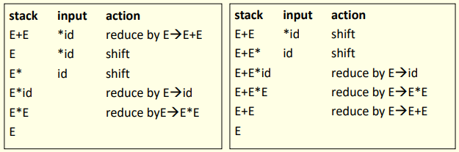
SHIFT REDUCE PARSING
SHIFT REDUCE CONFLICT
Consider the grammar E→ E+E| E*E | id
And the input id+id*id

Slide 26
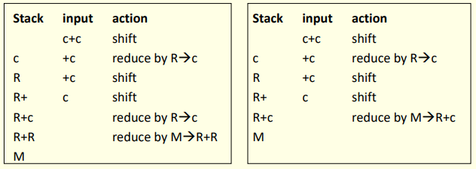
SHIFT REDUCE PARSING
REDUCE REDUCE CONFLICT
Consider the grammar M→ R+R| R+c | R ; R→c
And the input c+c

Slide 27
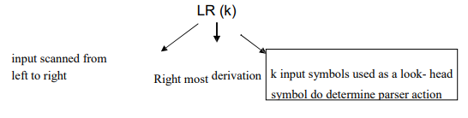
SHIFT REDUCE PARSING
• An ambiguous grammar can never be a LR grammar

Slide 28
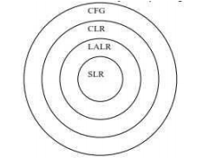
TYPES OF SHIFT REDUCE PARSING
There are two main categories of shift-reduce parsers
Operator-Precedence Parser
– simple, but only a small class of grammars.
2. LR-Parsers
– Covers wide range of grammars.
• SLR – Simple LR parser
• CLR – most general LR parser (Canonical LR)
• LALR – intermediate LR parser (Look Ahead LR)
– SLR, CLR and LALR work same, only their parsing tables are different.

Slide 29
OPERATOR PRECEDENCE PARSING
The largest class of grammars for which shift-reduce parsers can be built successfully –the LR grammars. However for a small but important class of grammars we can easily construct efficient shift-reduce parser by hand. These grammars have the property (among other essential requirements) that no production right side is ε or has two adjacent non terminals. A grammar with the latter property is called an operator grammar.

Slide 30
OPERATOR PRECEDENCE PARSING
• Operator grammar
– small, but an important class of grammars
– we may have an efficient operator precedence parser (a shift-reduce parser) for an operator grammar.
• In an operator grammar, no production rule can have:
– ε at the right side
– two adjacent non-terminals at the right side.

Slide 31

OPERATOR PRECEDENCE PARSING
Examples:

Slide 32
OPERATOR PRECEDENCE PARSING
Advantages:
Simple
Powerful enough for expressions in programming languages
Disadvantages:
It cannot handle the unary minus (the lexical analyzer should handle the unary minus).
Small class of grammars.
Difficult to decide which language is recognized by the grammar.

Slide 33
INTRODUCTION TO LR PARSING
The most prevalent type of bottom-up parser today is based on a concept called LR(k) parsing; the “L" is for left-to-right scanning of the input, the “R" for constructing a rightmost derivation in reverse, and the k for the number of input symbols of look ahead that are used in making parsing decisions. The cases k = 0 or k = 1 are of practical interest, and we shall only consider LR parsers with k 1 here. When (k) is omitted, k is assumed to be 1.

Slide 34
Why LR PARSING
LR parsing is attractive because:
LR parsers can be constructed to recognize virtually all programming-language constructs for which context-free grammars can be written.
The LR parsing method is the most general non backtracking shift-reduce parsing method known, yet it can be implemented as efficiently as other shift-reduce methods.
An LR parser can detect a syntactic error as soon as it is possible to do so on a left-to-right can of the input
The class of grammars that can be parsed using LR methods is a proper superset of the class of grammars that can be parsed with predictive parsers,

Slide 35
LR PARSING
• Input buffer contains the input string.
• Stack contains a string of the form S0X1 S1X2……Xn Sn where each Xi is a grammar symbol and each Si is a state.
• Table contains action and goto parts.
• action table is indexed by state and terminal symbols.
• goto table is indexed by state and non terminal symbols.

Slide 36
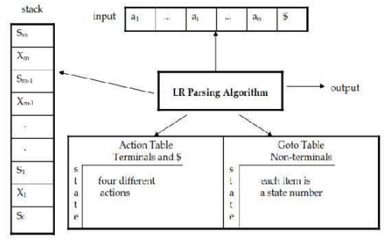
LR PARSING
Parser Configuration

Slide 37

LR PARSING
A configuration of a LR parsing is:
• Sm and ai decides the parser action by consulting the parsing action table. (Initial Stack contains just So )
• A configuration of a LR parsing represents the right sentential form: X1 ... Xm ai ai+1 ... an $

Slide 38
LR PARSING Algorithm
INPUT: An input string w and an LR-parsing table with functions ACTION and GOTO for a grammar G.
OUTPUT: If w is in L(G), the reduction steps of a bottom-up parse for w; otherwise, an error indication.
METHOD: Initially, the parser has s0 on its stack, where s0 is the initial state, and w$ in the input buffer.

Slide 39
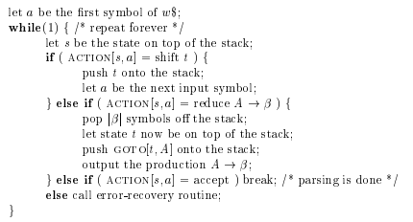
LR PARSING Algorithm
LR-parsing program

Slide 40
LR PARSING
Parser Actions
shift s -- shifts the next input symbol and the state s onto the stack ( So X1 S1 ... Xm Sm, ai ai+1 ... an $ ) ->( So X1 S1 ... Xm Sm ai s, ai+1 ... an $ )
reduce A→β (or rn where n is a productionnumber) – pop 2|β| (=r) items from the stack; let us assume that β = Y1Y2...Yr – then push A and s where s=goto[sm-r,A] ( So X1 S1 ... Xm Sm, ai ai+1 ... an $ )->(So X1 S1 ... Xm-r Sm-r A s, ai ... an $ ) – Output is the reducing production reduce A→β – In fact, Y1Y2...Yr is a handle. X1 ... Xm-r A ai ... an $ ⇒ X1 ... Xm Y1...Yr ai ai+1 ... an $

Slide 41
LR PARSING
Parser Actions
3. Accept – Parsing successfully completed.
4. Error -- Parser detected an error (an empty entry in the action table)
Example:
Let following be the grammar and its LR parsing table.
1) E → E+T 2) E → T 3) T → T*F 4) T → F 5) F →(E) 6) F → id

Slide 42
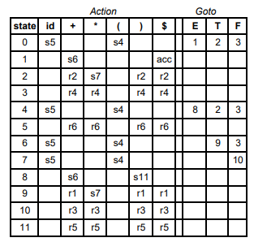
LR PARSING
Example: LR parsing table

Slide 43
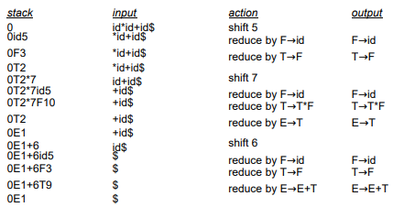
LR PARSING
Example: The action of the parser would be as follows:

Slide 44
CONSTRUCTING SLR PARSING TABLES
An LR parser using SLR parsing tables for a grammar G is called as the SLR parser for G.
If a grammar G has an SLR parsing table, it is called SLR grammar.
Every SLR grammar is unambiguous, but every unambiguous grammar is not a SLR grammar.
Augmented Grammar: G’ is G with a new production rule S’→S where S’ is the new starting symbol.

Slide 45
CONSTRUCTING SLR PARSING TABLES
LR(0) Items
• An LR(0) item of a grammar G is a production of G a dot at the some position of the right side.
Example: A → aBb
Possible LR(0) Items (four different possibility):
A → .aBb A → a.Bb A → aB.b A → aBb.
• Sets of LR(0) items will be the states of action and goto table of the SLR parser.
• A collection of sets of LR(0) items (the canonical LR(0) collection) is the basis for constructing SLR parsers.

Slide 46
CONSTRUCTING SLR PARSING TABLES
Closure Operation
If I is a set of LR(0) items for a grammar G, then closure(I) is the set of LR(0) items constructed from I by the two rules:
Initially, every LR(0) item in I is added to closure(I).
If A → α.Bβ is in closure(I) and Bγ→ is a production rule of G; then B→.γ will be in the closure(I). We will apply this rule until no more new LR(0) items can be added to closure(I).

Slide 47
CONSTRUCTING SLR PARSING TABLES
Closure Operation
Example:
E’ → E
E → E+T
E → T
T → T*F
T → F
F → (E)
F → id
Closure(
{E’ → .E}) = {
E’ → .E,
E → .E+T,
E → .T,
T → .T*F,
T → .F,
F → .(E),
F → .id }

Slide 48
CONSTRUCTING SLR PARSING TABLES
Goto Operation
If I is a set of LR(0) items and X is a grammar symbol (terminal or non-terminal), then goto(I,X) is defined as follows:
If A → α.Xβ in I then every item in closure({A → αX.β}) will be in goto(I,X).

Slide 49
CONSTRUCTING SLR PARSING TABLES
Goto Operation
Example: I = { E’ → .E, E → .E+T, E → .T, T → .T*F, T → .F, F → .(E), F → .id }
goto(I,E) = { E’ → E., E → E.+T }
goto(I,T) = { E → T., T → T.*F }
goto(I,F) = {T → F. }
goto(I,() = {F→ (.E), E→ .E+T, E→ .T, T→ .T*F, T→ .F, F→ .(E), F→ .id }
goto(I,id) = { F → id. }

Slide 50
Thank You

